Slide 1
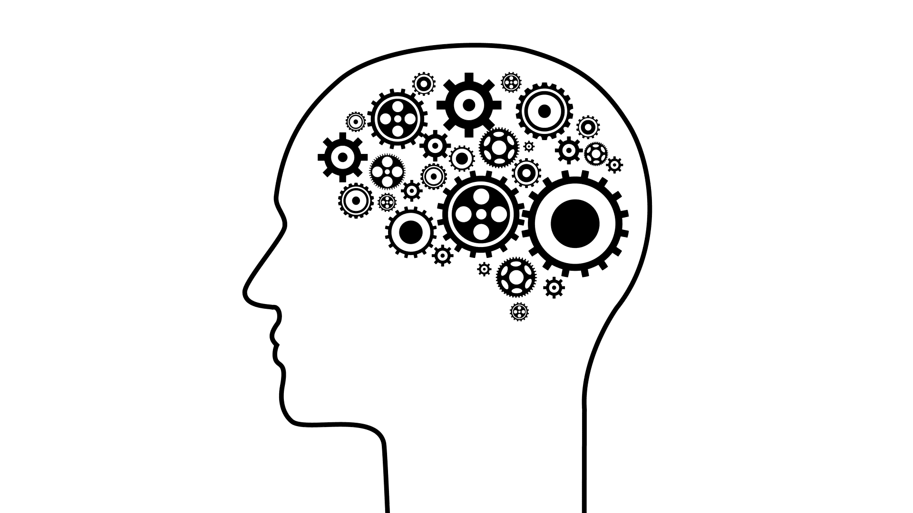
Think Again
A presentation by Bob Pearce and Nateri Madavan
☺
Dr. Madavan the Younger

Slide 2


A brief outline
0 | What is rethinking?
I | Individual rethinking
II | Interpersonal rethinking
III | Collective rethinking
IV | Conclusions
Notes:
- Following book sections
- Added what is rethinking section as I think it’s an important place to start.
- Individual rethinking is about updating our beliefs as individuals.
- Interpersonal rethinking is about updating the beliefs of others.
- Collective rethinking is about building a community that encourages rethinking.
- Conclusions outlines things we can do to rethink across all these spectra.

Slide 3
What is rethinking?

Slide 4





What does rethinking mean?
Processing Alternatives
Gathering Information
Making Decisions
RETHINKING
Notes:
Consider an example, such as starting a new research or industry initiative.
- Begin with information gathering (solicitation)
- Must consider all alternatives and identify the “best”
- Ultimately leading to a decision
- Rethinking seeks to reassess the decision, not by reprocessing alternatives, but by regathering information
- You may notice that the information looks different -> leading to a piece of the answer of why we need rethinking

Slide 5

Why do we need rethinking?
Inadequate Information
Incomplete acquisition
Information changes over time
Bad Information
Inherent biases
Withholding information
Presenting incorrect data
Rethinking
Changes in Processing
Growth as individuals
Changes in personnel
Notes:
Inadequate information
- solicitation that doesn’t reach a complete audience.
- information changes over time (i.e. electric aviation impractical 40 yrs ago, but it’s important today)
Bad Information
- people are biased.
- vested interests of individuals dictates what information is available (malicious or not)
Changes in processing
- we change our views and perceptions over time (growth)
- changing jobs means people needing to reassess and understand prior decisions

Slide 6
Individual Rethinking
… updating our own views
Notes:
This section is about updating our own beliefs

Slide 7
Discussion Section
What are your boiling frogs?

Slide 8
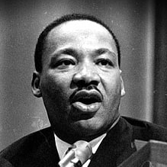
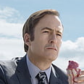
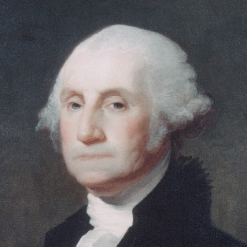
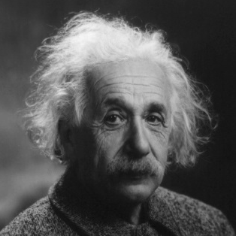
The Preacher, Prosecutor, and Politician
Preacher
Evangelizes beliefs in the face of attacks.
I’m right!
Prosecutor
Identifies and attacks flaws in others’ arguments.
You’re wrong!
Politician
Campaigns and lobbies for their beliefs to draw support.
We’re right! They’re wrong!
Scientist
Hypothesizes, tests, and updates beliefs.
I might be wrong!
Notes:
When sharing our beliefs, we often take on one of these three roles.
Preacher – when somebody tells us that we are wrong, we expound and defend our view
Prosecutor – when somebody says something we don’t agree with, we attack their view, pick apart and focus on their errors
Politician – decisions are often presumed to be binary and we fight for our side, while ignoring and belittling the opposing view
All assume their beliefs represent truth.
… There is a fourth option (click for animation)… the scientist
The scientist’s mode of thinking does not assume that their beliefs are true, and in fact often assumes them to be false.
This allows for their beliefs to shift and grow to better reflect he world around them.
So how do we think like a scientist?

Slide 9
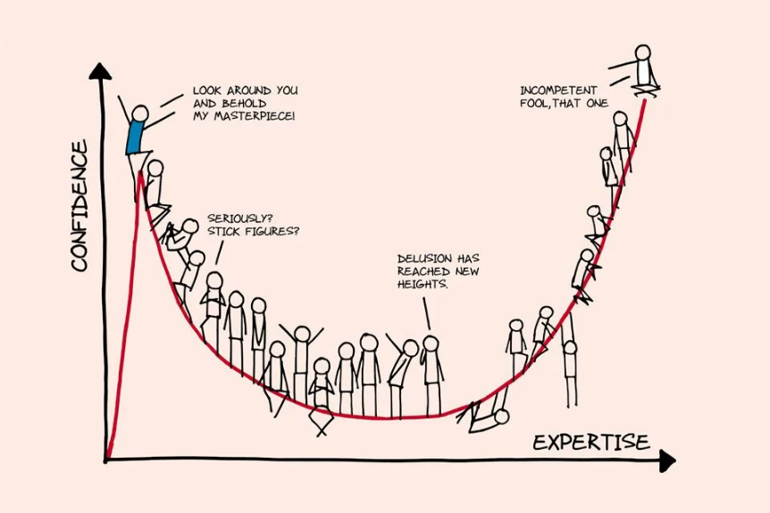
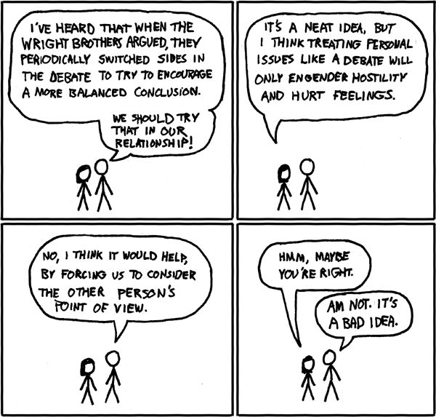
How do you think like a scientist?
Confident humility: having faith in our abilities even if we don’t have the right solution or question.
Embrace imposter syndrome.
The Business Times/Image by Kenneth Lim
Finding out you are wrong today means you will be less wrong tomorrow.
Seek out disagreeability.
XKCD
Notes:
Thinking like a scientist requires keeping an open mind.
- Dunning-Kruger effect says most confident people are often those with the least competence (or expertise)
- The peak is called “Mount Stupid”
- Pride -> conviction -> confirmation/desirability bias -> validation -> pride
- Humility -> doubt -> curiosity -> discovery -> humility
- Confidence is okay as long as it is in our abilities but not your tools
Embrace being wrong
- Wright brothers would often get into deep arguments for days/weeks/months
- At the end, they would come back together taking the opposing point of view
- Provides a better and deeper understanding of the merits of any solution
- Pixar riding high after Toy Story in early 2000s
- Brad Bird wanted to do something new, but was told it was impossible
- He sought out the most disagreeable ppl, the black sheep, the pirates
- The result was The Incredibles
- Disagreeable ppl challenge and allow for rethinking, pushing the boundaries
… be a scientist

Slide 10
Interpersonal Rethinking
… opening other people’s minds

Slide 11
Debate Demonstration
Should preschools be subsidized by the government?
Notes:
Before question: who thinks preschools should be subsidized?
After question: who won the debate?
This was paraphrasing a real debate between expert debater, Harish Natarajan, and the first AI debater, called Project Debater, made by IBM.

Slide 12
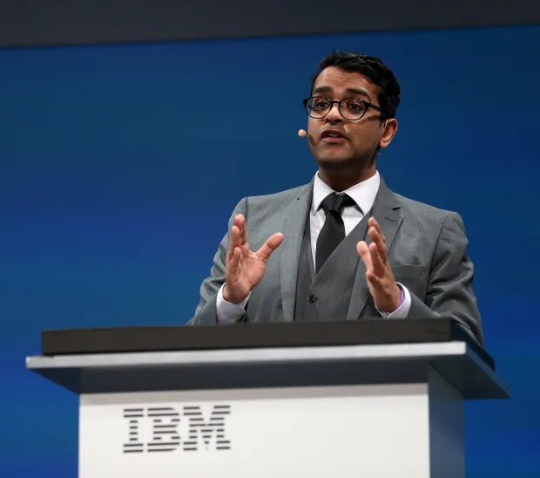
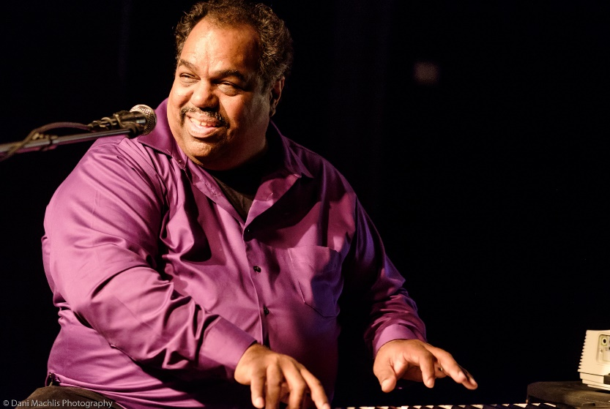
How do you change others’ beliefs?
Harish Natarajan
Seek common ground and focus on fewer but more compelling arguments.
The Mercury News/Image by Jane Tyska
Daryl Davis
In the face of disagreement, ask why rather than explain why not.
Wikipedia
Debate is a dance, not a war.
Notes:
What makes Harish’s arguments so persuasive?
- First he sought out to establish common ground.
- Even if you disagree, you understand his viewpoint is not that far off from our own.
- The AI debater had a lot of arguments, many of which only weakened its point.
- Harish had only a few arguments, but they were all strong.
Another example is the heroic story of Daryl Davis, a Blues musician who gained additional fame for single-handedly caused over 200 Klansmen to give up their robes.
- Daryl Davis originally started by playing in a bar.
- An older white man approached after saying he was surprised a black man could play like Jerry Lee Lewis.
- Daryl said he was friends with Jerry Lee Lewis and Lewis had been inspired by many black musicians.
- The man skeptically invited for a drink, before revealing himself as a Klansman.
- Daryl initially laughed, and the man showed his membership card.
- Daryl asked him the simple question “how can you hate me when you don’t even know me?”
- This sparked the beginning of a friendship that ultimately led to the man giving Daryl his robe.
- Daryl’s story is important because he did not attack or diminish the man’s view.
- Rather he questioned how he could feel that way and in that way gave him a chance to learn.
Debate is a dance, in that it is not about winning or losing.
- There is a back and forth and almost a partnership.
- Sometimes you take a step back and sometimes forward.
- Changing minds requires yours to be open to understanding their movements.
… be a scientist

Slide 13
Collective Rethinking
… creating a community of lifelong learners

Slide 14
Story Time
An Astronaut’s Tale
Notes:
Failure to rethink the problem as it occurred and the result was potentially dangerous.
Challenger faced a similar problem
- The o-rings were known to fail, but were not rethought
- Cold snap resulted in a complete failure
Columbia
- The fallen insulation was a known issue
- Insulation had fallen in the past, so was discounted
- An engineer asked to reassess, but was told that it was not important
- Later that engineer did not feel comfortable speaking up

Slide 15
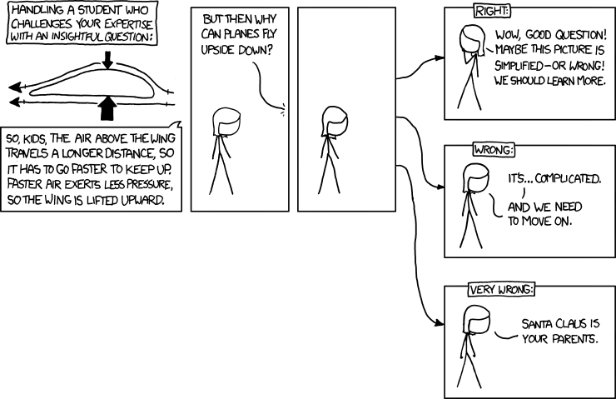
How do you foster and encourage rethinking?
Psychological safety
Can you take risks without being punished?
Ellen Ochoa’s Notecard
What leads you to that assumption? Why do you think it is correct? What might happen if it’s wrong?
What are the uncertainties in your analysis?
I understand the advantages of your recommendation. What are the disadvantages?
Be humble. Be curious.
XKCD
Notes:
The NASA engineers who voiced concerns were dismissed.
It’s not surprising they stopped voicing opinions.
In doing so, NASA lost the ability to respond to these failures before they happened.
All rethinking was reactionary rather than proactive.
All rethinking was done after disaster rather than used to mitigate potential disaster.
Highlights the need for psychological safety.
- Engineers should have felt comfortable and even emboldened to raise concerns and address them before they happened.
- Do not just accept things because that is how they were done.
- Ask the question why is that true? If the answer is somebody said so, then perhaps it should be rethought.
Ellen Ochoa, first Latina in space, took over 1 month before Challenger.
- In the wake, asked how this could have happened.
- Tried to begin rethinking beforehand and kept these questions.
- Goal was encouraging rethinking before
Comic illustrates how it is important to address questions in which our knowledge fails.
- Do not move on or ignore.
- Study and learn from it as a group or organization.
As leaders and decision-makers, we need to foster environments in which people are comfortable sharing their views.
- You don’t have information, but you are working with people who do.
- Be humble, and acknowledge your lack of knowledge, so you can gain as much as you can.
- Be curious, and ask questions to fill the gaps in your understanding.
… be a scientist (and in this case a student).

Slide 16
Conclusions

Slide 17



Actions to encourage rethinking
Individual Rethinking
Develop a habit of continuous rethinking.
Calibrate your confidence.
Invite disagreement and challenges.
Interpersonal Rethinking
Ask questions.
Approach disagreements as a dance rather than a battle.
Collective Rethinking
Challenge best practices.
Establish psychological safety.
Encourage dissenting views.
Notes:
Individual rethinking
Develop a habit of thinking again.
Think like a scientist.
Remain unattached to ideas.
Seek out opposing views.
Calibrate your confidence.
Beware of being stranded on Mount Stupid.
Harness benefit of the doubt.
Embrace the joys of being wrong.
Invite others to question your thinking.
Learn something new from each person you meet.
Build a challenge network, not just a support network.
Don’t shy away from constructive conflict.
Interpersonal rethinking
Ask better questions.
Practice the art of persuasive listening.
Question how rather than why.
Ask “What evidence would change your mind?”
Ask how people originally formed an opinion.
Approach disagreements as dances, not battles.
Acknowledge common ground.
Remember that less is often more.
Reinforce freedom of choice.
Have a conversation about the conversation.
Collective rethinking
Abandon best practices.
Allow free thinking and open dialogue.
Ask why something is true, and do not accept “because somebody said”
Establish psychological safety.
Allow risk-taking.
Accept and acknowledge your own limitations.
Encourage dissenting views.
Commit to discussing peoples’ disagreements.
Discuss all viewpoints.

Slide 18
Yet another template for decision-making
MAKING DECISIONS
The decision and alternatives.
Pros and cons of all options.
Rationale behind the choice.
Contingencies under which alternatives would be taken.
RETHINKING
Is prior information valid?
Is there additional information?
Did any contingencies occur?
Does the reasoning still hold?

Slide 19
Thank you!
Notes:
Hopefully, we were able to make you rethink rethinking ☺

Slide 20
Discussion Section
What are your boiling frogs?

